Slide 1
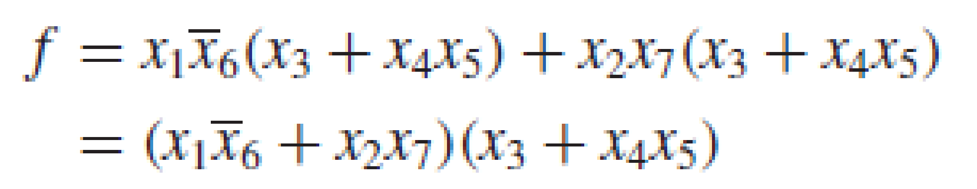
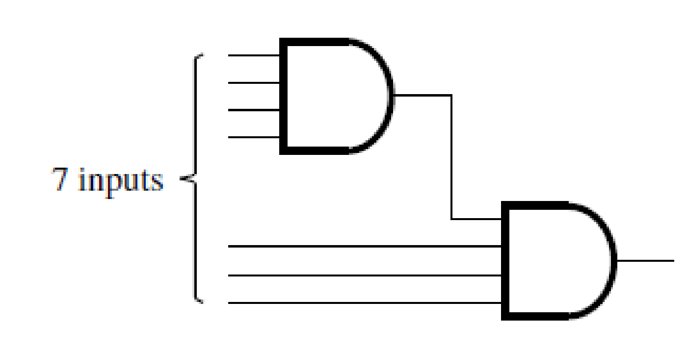
Multilevel Synthesis
Factoring
Fan-in Problem
No. of inputs that a gate can drive is called fan in

Slide 2
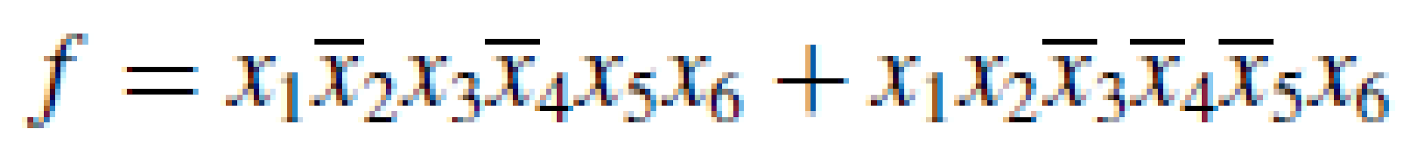
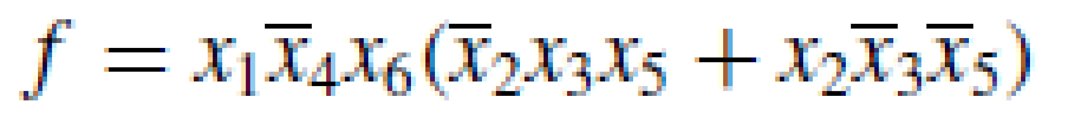
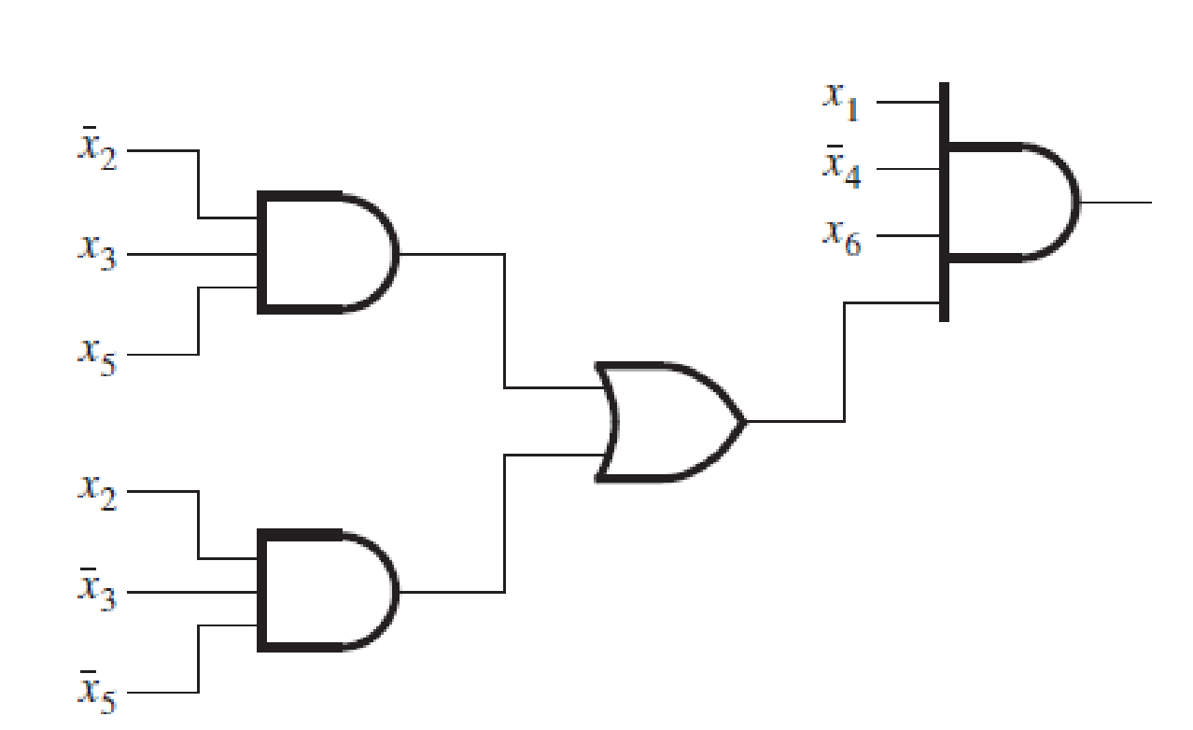
Factoring can be used to deal with the fan-in problem.

Slide 3
Functional Decomposition
Using factoring, multilevel circuits are used to deal with fan-in limitations. However, such circuits may be preferable even if fan-in is not a problem. In some cases the multilevel circuits may reduce the cost of implementation. On the other hand, they usually imply longer propagation delays, because they use multiple stages of logic gates.
Complexity of a logic circuit can often be reduced by decomposing a two-level circuit into subcircuits, where one or more subcircuits implement functions that may be used in several places to construct the final circuit

Slide 4
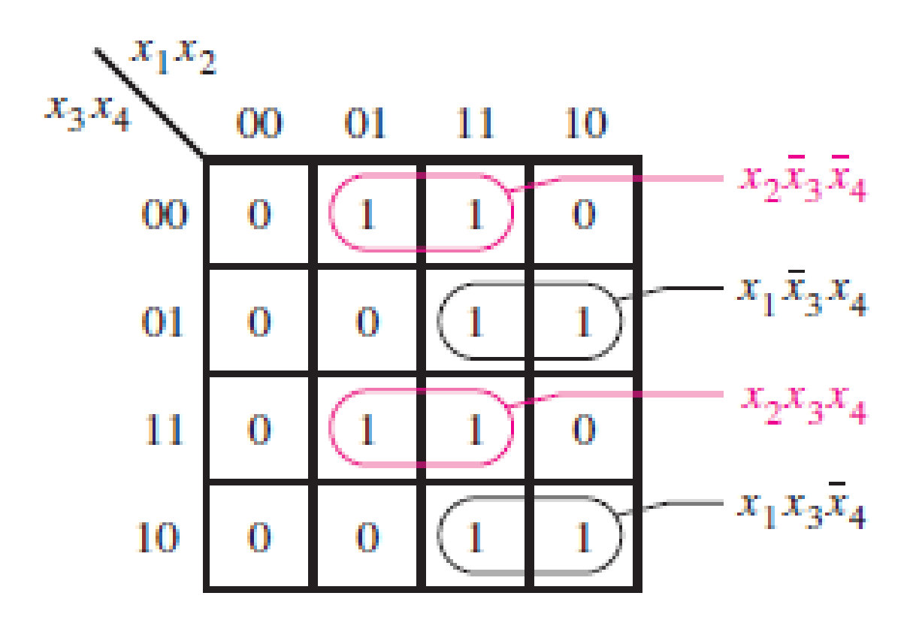
Example 1
Assuming that inputs are available only in their true form, this expression has seven gates and 18 inputs to gates, for a total cost of 25.
To perform functional decomposition we need to find one or more subfunctions that depend on only a subset of the input variables.

Slide 5
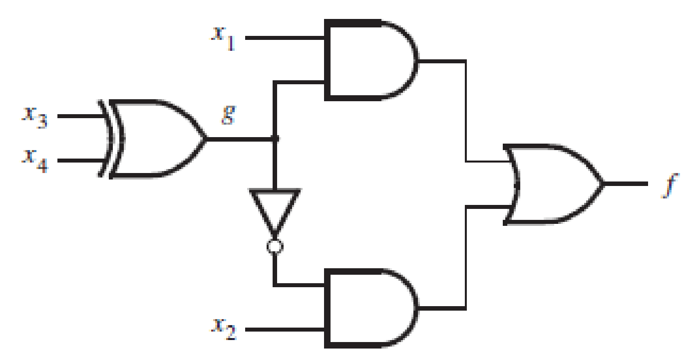
Now let g(x3, x4) = x3’x4 + x3x4’ and observe that g = x3’x4’ + x3x4. The decomposed function f can be written as
f = x1g + x2g’

Slide 6
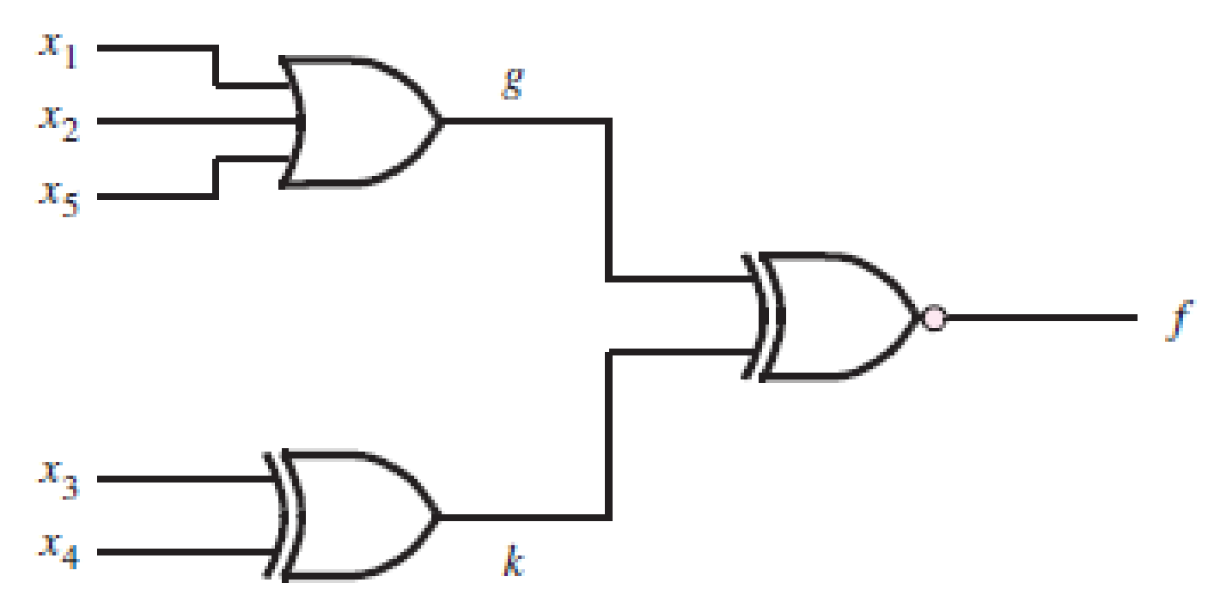
Example 2
= x3’x4(x1+x2+x5) + x3x4’(x1+x2+x5) + x1’x2’x5’(x3’x4’+x3x4)
= (x1+x2+x5)(x3’x4+x3x4’) + x1’x2’x5’(x3’x4’+x3x4)
let g=x1+x2+x5, and k= x3’x4+x3x4’. Then
f= gk +g’k’ = (g XOR k)’
It requires a total of three gates and seven inputs to gates, for a total cost of 10.
The largest fan-in of any gate is three.
The minimum cost SOP has a cost of 55 (14 gates and 41 inputs) with largest fan in 8

Slide 7
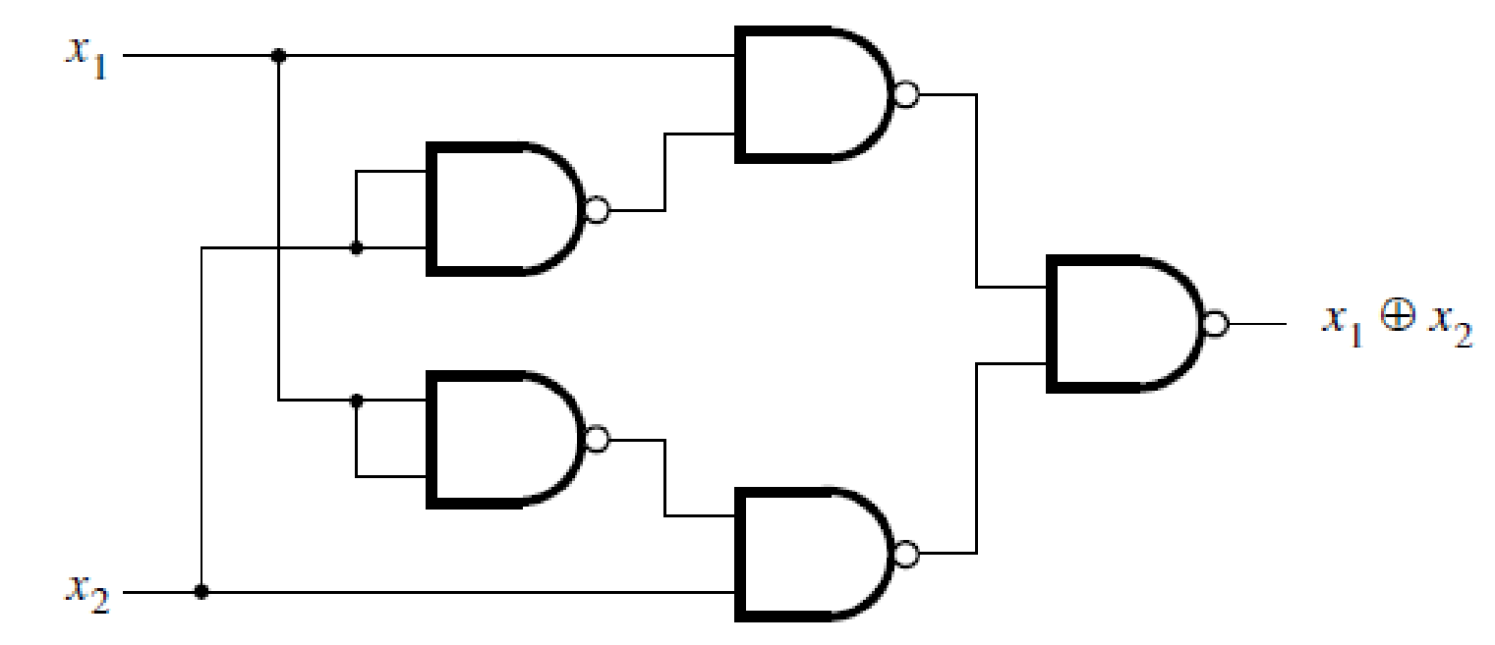
Implement the XOR function using only NAND gates.
x1 XOR x2 = x1’x2 + x1x2’

Slide 8

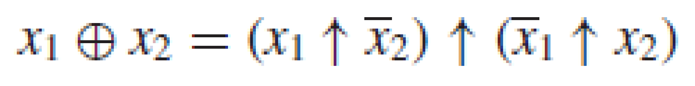
Exploit functional decomposition to find a better implementation of XOR using only NAND gates. Let the symbol ↑ represent the NAND operation so that x1 ↑ x2 = (x1 · x2)’.
To find a decomposition, we can manipulate the term (x1 ↑ x2’) as follows:

Slide 9
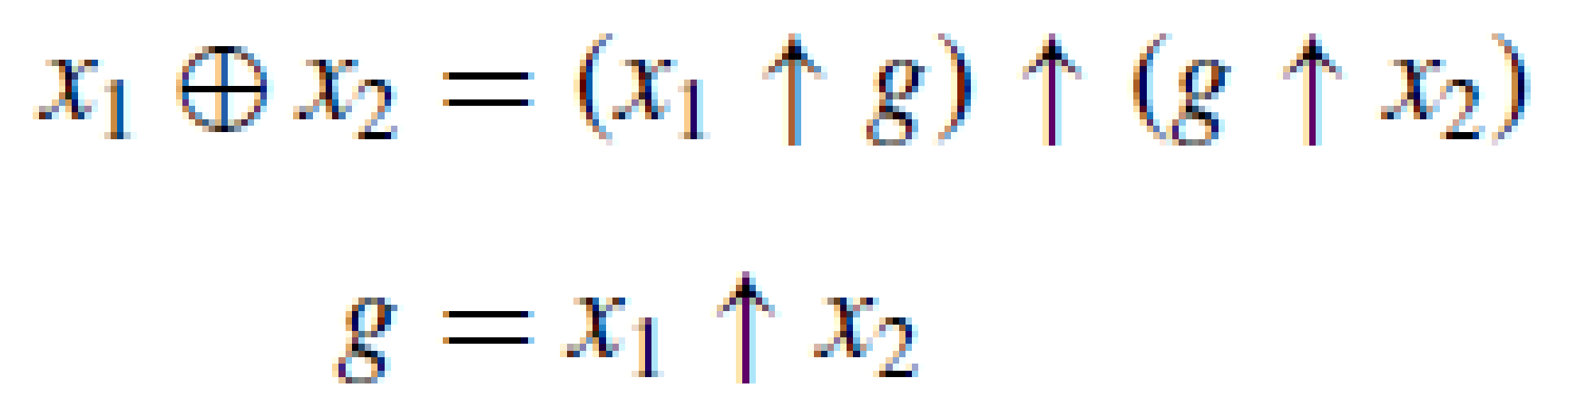
We can perform a similar manipulation for (x1’ ↑ x2)
(x1’ ↑ x2) = (x1’x2)’ = (x2(x1’+x2’))’ = (x2 ↑ (x1’+x2’))
DeMorgan’s theorem states that x1’ + x2’ = x1 ↑ x2; hence we can write
Now we have a decomposition

Slide 10
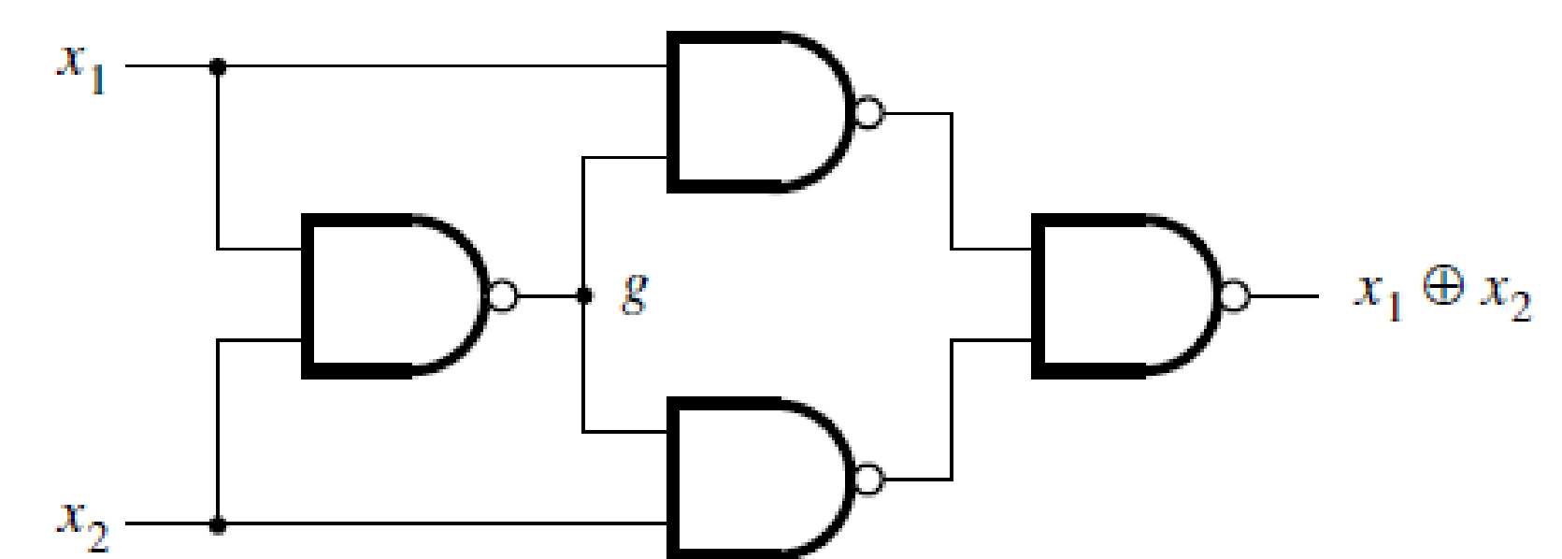
Optimal NAND gate implementation

Slide 11
Find the minimum-cost circuit for the function f (x1, . . . , x4) = m(0, 4, 8, 13, 14, 15).
Assume that the input variables are available in uncomplemented form only.

